Slide 1

What are the characteristics of High-Rated Most-Popular Apps?
A Case Study on Free Android Applications

Slide 2
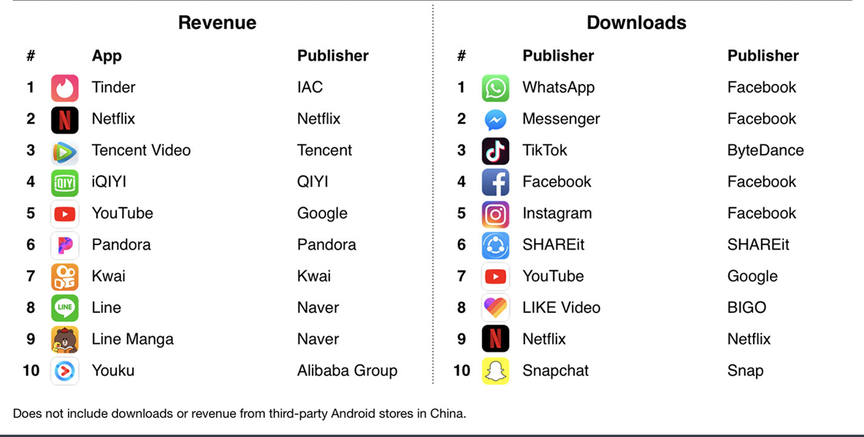
Notes:
This is a list of the most downloaded apps and the apps that generated the highest revenue for 2019.

Slide 3
Motivation
Majority of developers are struggling to break even
Knowing the characteristics of highly downloaded applications is hence crucial and is fact the first step towards successful development and evolution of apps

Slide 4
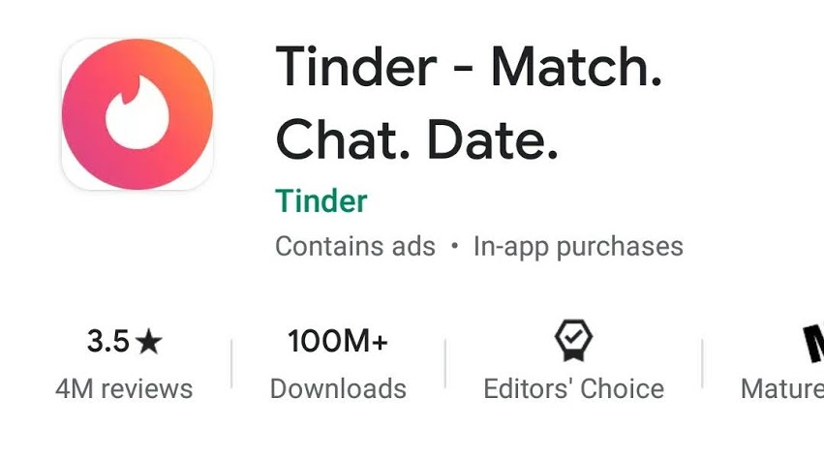
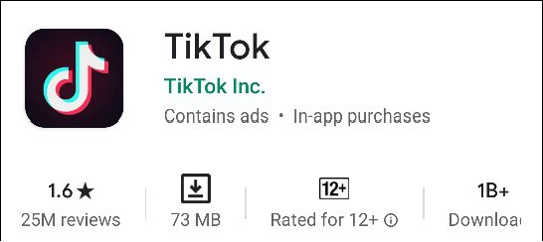
High-Rated Apps vs Most-Popular Apps
Apple Music – 3.1 with 50M + downloads
Google Classroom – 2.5 with 100M+ downloads
McDonalds Canada – 3.0 with 1M+ downloads

Slide 5
Features
Size of App
Complexity of the Code
Dependence on Libraries
Quality of Library Code
Complexity of UI
Requirements on Users
Marketing Efforts
Category of App

Slide 6
Research Questions
Is there a relationship between each factor and number of downloads?
What are the important factors that could indicate, with high probability, that an app will have a high number of downloads?
What is the difference between the characteristics of the Most-Popular Apps vs the characteristics of High-Rated Apps

Slide 7
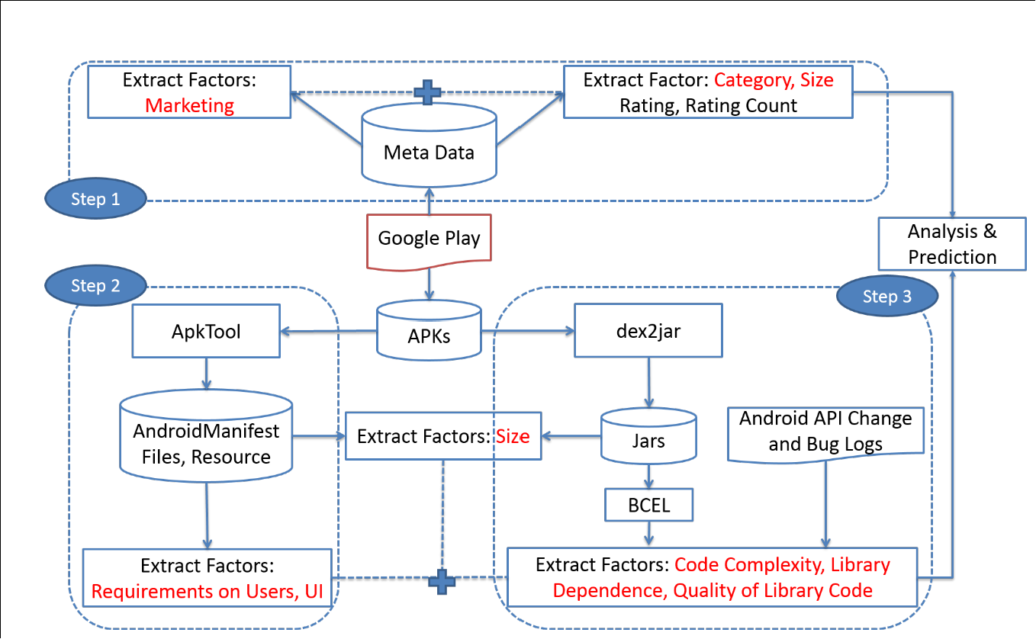
Factor Extraction Methodology and Data Processing Steps

Slide 8
References
http://www.developereconomics.com/reports/app-economy-forecasts-2013-2016/
https://www.forbes.com/sites/tristanlouis/2013/08/10/how-much-do-average-apps-make/
G. Bavota, M. L. V´asquez, C. E. Bernal-C´ardenas, M. D. Penta, R. Oliveto, and D. Poshyvanyk. The impact of API change- and faultproneness on the user ratings of android apps. IEEE Trans. Software Eng., 41(4):384–407, 2015.
M. Thelwall, K. Buckley, and G. Paltoglou. Sentiment strength detection for the social web. Journal of the American Society for Information Science and Technology, 63(1):163–173, 2012.
T. Zimmermann, R. Premraj, and A. Zeller. Predicting defects for eclipse. In Predictor Models in Software Engineering, 2007. PROMISE’07: ICSE Workshops 2007. International Workshop on, pages 9–9. IEEE, 2007

Slide 9
Thank you

